Slide 1

Measurement of Growth and Development
Part 2 : Physiologic Measurements
Third Stage
Dr. Moustafa Alshammari
Pediatric Lab

Slide 2
Physiologic measurements
Physiologic measurements, key elements in evaluating physical status of vital functions, include temperature, pulse, respiration, and blood pressure. Compare each physiologic recording with normal values for that age-group. In addition, compare the values taken on preceding health visits with present recordings. For example, a falsely elevated blood pressure reading may not indicate hypertension if previous recent readings have been within normal limits. The isolated recording may indicate some stressful event in the child’s life.

Slide 3
Temperature
One of the most important influences on the accuracy of temperature is improper temperature-taking technique.
Because children generally dislike rectal temperature measurement, tympanic thermometers may be used for infants who are more than 3 months old, and oral thermometers may be used for children more than 4 to 5 years old.

Slide 4
Temperature
The axial route is preferred, but if a rectal temperature is required, carefully insert a well-lubricated thermometer no further than 1/2 to 1 inch to avoid rectal perforation.
Notes:
In centimeters, ½ inch ≈ 1.27 cm.
2.54 cm

Slide 5
Fahrenheit to Centigrade Conversion Formulas
°F = (°C × 9/5) + 32, or (°C × 1.8) + 32
°C = (°F - 32) × 5/9, or (°F - 32) × 0.55

Slide 6
Fahrenheit to Centigrade Conversion Formulas
Example:
To convert 25°C to Fahrenheit:
°F=(25×1.8)+32=45+32=77°F°
To convert 77°F to Celsius:
°𝐶=(77−32)×59=45×5/9≈25°𝐶°

Slide 7
Fahrenheit to Centigrade Conversion Formulas
°F = (°C × 9/5) + 32, or (°C × 1.8) + 32
°C = (°F - 32) × 5/9, or (°F - 32) × 0.55

Slide 8
Type of thermometer
mercury glass thermometers
Digital Thermometer / Electronic Thermometer
Infrared Thermometer
Ear-Based Temperature Sensor

Slide 9
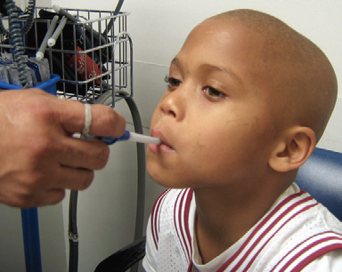
Temperature measurement locations for infants and children:
Oral site:
Place tip under tongue in right or left posterior sublingual pocket, not in front of tongue. Have child keep mouth closed without biting on thermometer.
Pacifier thermometers measure intraoral or supralingual temperature and are available but lack support in the literature.
Several factors affect mouth temperature: eating and mastication, hot or cold beverages, open-mouth breathing, ambient temperature.

Slide 10
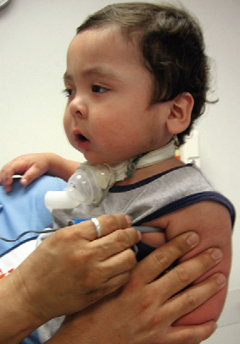
Temperature measurement locations for infants and children:
Axillary site
Place tip under arm in center of axilla and keep close to skin, not clothing. Hold child’s arm firmly against side.
Temperature may be affected by poor peripheral perfusion (results in lower value), clothing or swaddling, use of radiant warmer, or amount of brown fat in cold-stressed neonate (results in higher value).
Advantage—Avoids intrusive procedure and eliminates risk of rectal perforation.

Slide 11
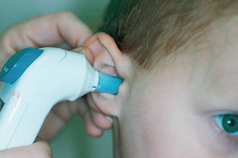
Temperature measurement locations for infants and children:
Ear Based (Aural) site
Insert small infrared probe deeply into canal to allow sensor to obtain measurement. Size of probe (most are 8 mm) may influence accuracy of result. In young children, this may be a problem because of small diameter of canal. Proper placement of ear is controversial related to whether the pinna should be pulled in manner similar to that used during otoscopy.

Slide 12
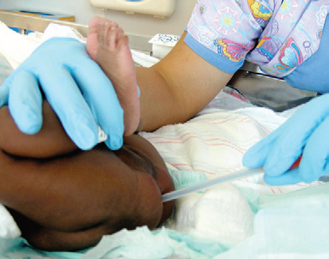
Temperature measurement locations for infants and children:
Rectal site
Place well-lubricated tip at maximum 2.5 cm (1 inch) into rectum for children and 1.5 cm (0.6 inch) for infants; securely hold thermometer close to anus.
Child may be placed in side-lying, supine, or prone position (i.e., supine with knees flexed toward abdomen); cover penis because procedure may stimulate urination. A small child may be placed prone across parent’s lap.

Slide 13
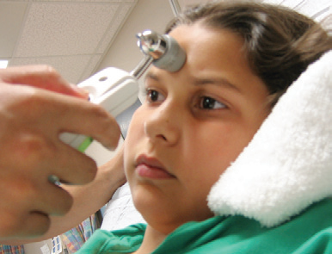
Temperature measurement locations for infants and children:
Temporal Artery site
An infrared sensor probe scans across forehead, capturing heat from arterial blood flow.
Temporal artery is only artery close enough to skin’s surface to provide access for accurate temperature measurement.

Slide 14
NURSING ALERT
The belief that core temperature can be estimated by adding 1° C to the temperature taken in the axilla is incorrect. Do not add a degree to the finding obtained by taking a temperature by the axillary route.

Slide 15
Pulse
A satisfactory pulse can be taken radially in children older than 2 years of age. However, in infants and young children, the apical impulse (heard through a stethoscope held to the chest at the apex of the heart) is more reliable.

Slide 16
Pulse
Count the pulse for 1 full minute in infants and young children because of possible irregularities in rhythm.
Compare radial and femoral pulses at least once during infancy to detect the presence of circulatory impairment, such as coarctation of the aorta.
At birth, the range of pulse 120 to 140 beats/min
Notes:
Coarctation of the aorta is a congenital (present at birth) heart defect characterized by a narrowing or constriction of the aorta, the major artery that carries oxygen-rich blood from the heart to the rest of the body. This narrowing usually occurs just after the aorta branches off to supply blood to the upper body, near the area where the ductus arteriosus (a vessel present during fetal development) is located. The condition can range from mild to severe and may go undiagnosed until later in life or be identified shortly after birth.

Slide 17
Pulse
Auscultate the apical pulse by using the diaphragm of the stethoscope over the point of maximal intensity (PMI), The PMI is located just left of the midclavicular line at the fourth intercostal space in children less than 7 years old and at the fifth intercostal space in older children.

Slide 18
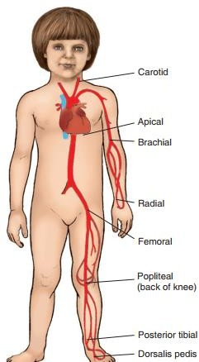
Locations of pulse

Slide 19
Respiration
At birth, respiratory rate average 30 to 60 breaths/min.
Respirations also should be measured before an infant is disturbed because the respiratory rate increases with crying.

Slide 20
Respiration
Take this while a child is sitting in a parent’s lap or lying quietly in a crib before lowering the side rail if possible
Infants tend to breathe with their abdominal muscles; therefore, it is as accurate to take respirations by counting movements of the abdomen as it is to count chest movements.
Count respirations for 1 full minute.

Slide 21
Respiration
Take this while a child is sitting in a parent’s lap or lying quietly in a crib before lowering the side rail if possible
Infants tend to breathe with their abdominal muscles; therefore, it is as accurate to take respirations by counting movements of the abdomen as it is to count chest movements.
Count respirations for 1 full minute.

Slide 22
Blood Pressure
Blood pressure is included in the routine physical assessment of all children older than 3 years of age.
Blood pressure is difficult to measure in infants because of mechanical problems.

Slide 23
Blood Pressure
For healthy term infants, blood pressure average 70-65/45 mm Hg.
Because measurement of blood pressure in a newborn is somewhat inaccurate, it is not routinely measured unless a cardiac anomaly is suspected, renal disorder such as, nephrotic syndrome and nephritis.

Slide 24
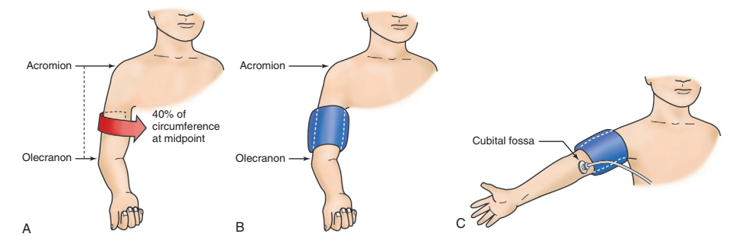
Blood Pressure
Determination of proper cuff size. A, Cuff bladder width should be approximately 40% of circumference of arm measured at a point midway between olecranon and acromion. B, Cuff bladder length should cover 80% to 100% of circumference of arm. C, Blood pressure should be measured with cubital fossa at heart level. Arm should be supported. Stethoscope bell is placed over brachial artery pulse, proximal and medial to cubital fossa and below bottom edge of cuff.

Slide 25
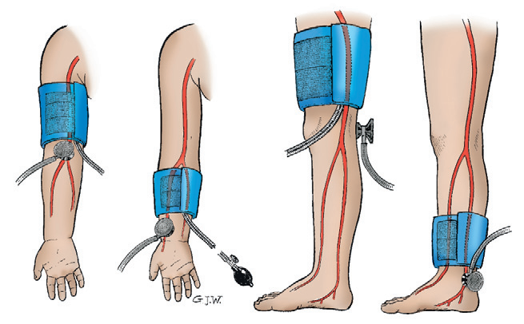
Sites for measuring blood pressure
Sites for measuring blood pressure. A, Upper arm. B, Lower arm or forearm. C, Thigh. D, Calf or ankle.

Slide 26
NURSING ALERT
When taking BP, use an appropriately sized cuff. When the correct size is not available, use an oversized cuff rather than an undersized one, or use another site that more appropriately fits the cuff size. Do not choose a cuff based on the name of the cuff (e.g., an “infant” cuff may be too small for some infants).
Compare BP in the upper and lower extremities to detect abnormalities, such as coarctation of the aorta, in which the lower-extremity pressure is less than the upper-extremity pressure.

Slide 27
Thank you

